Slide 1
Chapter 10 - Creating Text Embedding Models
From the book Hands-On Large Language Models

Slide 2
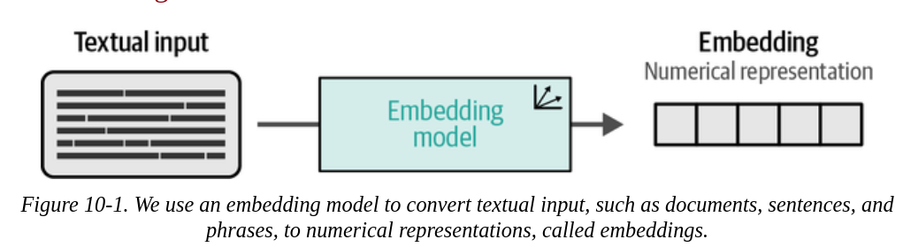
Embedding Models
As we know, we first have to convert this textual data to numeric representations.
The process of converting from text to numeric representations is referred to as ‘embedding’ the input to output usable vectors, namely embeddings.

Slide 3
Embedding Models
This process is performed by an LLM, or an embedding model.
The purpose of this model is to, accurately as possible, capture the features or representations the textual data as an embedding.

Slide 4
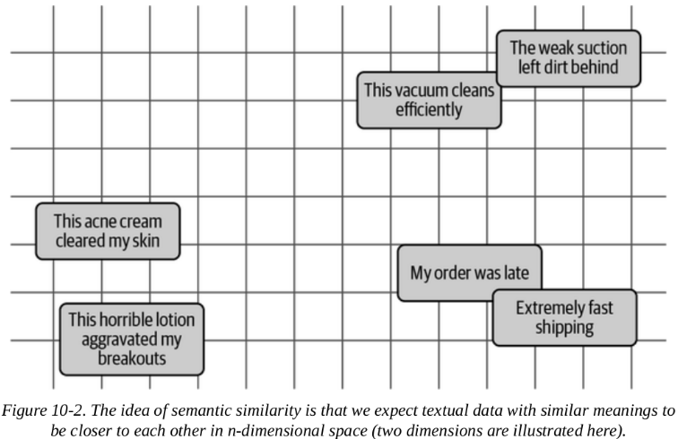
Embedding Models
But what does it mean to be accurate in representations?
Means the model can capture the meaning or the semantic nature of the text
If the model can capture this, then we would have the right embeddings
important for an embedding space, where semantic similarity is calculated using the embedding values.

Slide 5
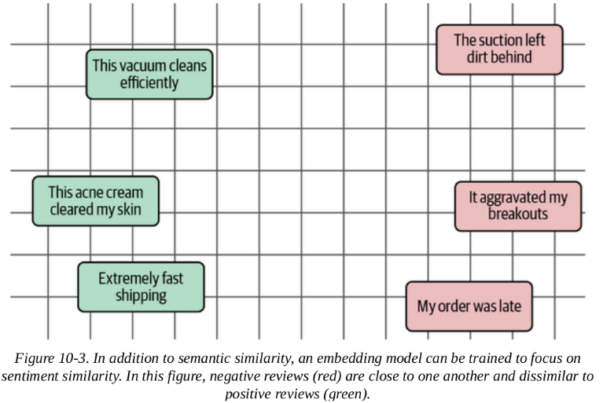
Embedding Models
But what does it mean to be accurate in representations?
But remember that not all embedding models are trained for semantic similarity.
When building a sentiment classifier, it is more important to correctly identify the sentiment of the text

Slide 6
What Is Contrastive Learning?
Contrastive Learning
a technique that aims to train an embedding model such that similar documents are closer in vector space while dissimilar ones are further apart.
The idea is the notion that the best way to teach a model what are similar and what are not is by giving it dissimilar and similar examples.
Contrasting similar and dissimilar examples

Slide 7
What Is Contrastive Learning?
A way to understand contrastive learning better is through explanations.
instead of asking 'Why did you rob the bank?' which asks the overall intent
The question could be phrased as 'Why did you rob the bank instead of obeying the law?'
This technique is called contrastive explanation, where there is P instead of Q.

Slide 8
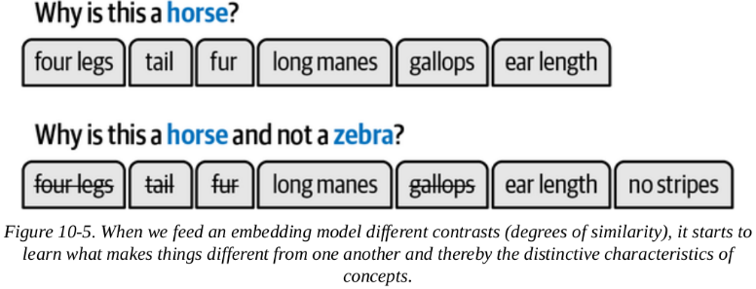
What Is Contrastive Learning?
Notice that this allows for a more specific 'reason'
It provides differentiation between similar and dissimilar examples.
Notice that getting rid of other characteristics makes the descriptors or features more dog-specific.

Slide 9
SBERT (Sentence-BERT)
sentence-transformers is the framework that has popularized contrastive learning in the NLP community.
Before sentence-transformers , sentence embeddings an architectural structure called cross-encoders with BERT.
Bi-encoders are more efficient, faster, and more straightforward
A cross-encoder allows 2 sentences to be passed to a Transformer at once and directly compares their similarity.
While this is powerful and accurate, it uses a lot of computational resources.

Slide 10
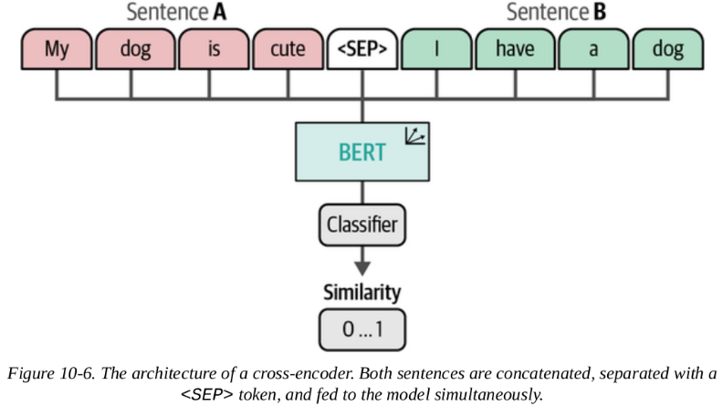
SBERT
A cross-encoder does not generate embeddings as its output
Instead, it generates a similarity score for a query-document pair.

Slide 11
SBERT
Cross-encoders output similarity scores, not embeddings
Cannot be used with vector databases for RAG systems
Bi-encoders generate separate embeddings for each sentence individually
These embeddings can be cached and reused for any comparison
Similarity calculated using cosine similarity

Slide 12
SBERT
Computational cost of using a cross-encoder instead of a bi-encoder:
Assume there are 100 documents,
And you need to find the similarity score for each pair
you would need n(n-1)/2 = 100(99)/2 = 4,950 feedforward passes
With a bi-encoder, comparing the documents would need 100 embeddings only.
Embeddings are cached and can be reused
Less accurate but scalable

Slide 13
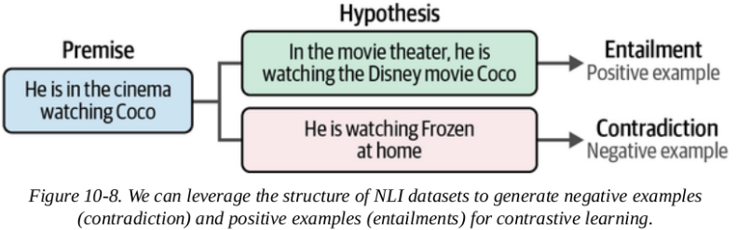
Creating an Embedding Model
Generating Contrastive Examples
Natural Language Inference (NLI) refers to the task of investigating whether, for a given premise, it entails the hypothesis (entailment), contradicts it (contradiction), or neither (neutral).

Slide 14
Creating an Embedding Model
The data used throughout creating and fine-tuning embedding models is derived from the General Language Understanding Evaluation (GLUE) benchmark, which consists of nine language understanding tasks.
We will be using data for one of the tasks called Multi-Genre Natural Language Inference (MNLI), a collection of 392,702 sentence pairs annotated with entailment (contradiction, neutral, entailment).

Slide 15
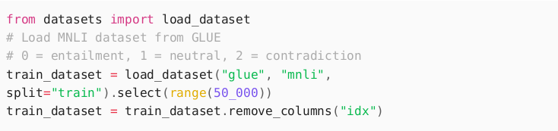
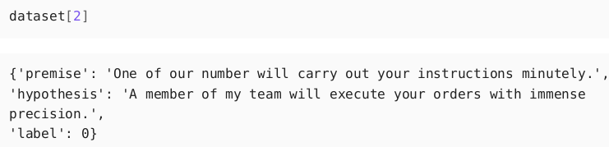
Creating an Embedding Model
We will use 50,000 of these pairs:

Slide 16
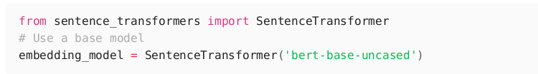
Train Model
To train a model from scratch we need to define 2 things:
A model to embed 2 individual words
A loss function to optimize the model
We will use BERT-base-uncased:

Slide 17
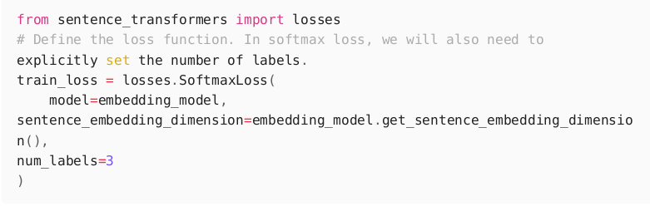
Train Model
For the loss function, We will use softmax loss of sentence-transformers:

Slide 18
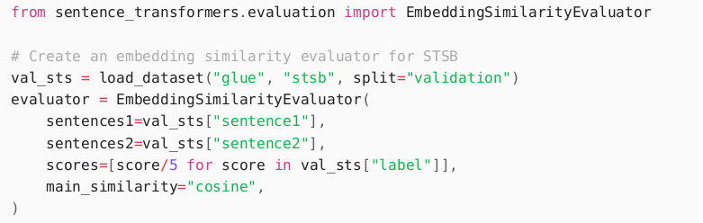
Train Model
We also need to define an evaluator to evaluate the model's performance during training.
This evaluation can be performed using the Semantic Textual Similarity Benchmark (STSB) - a collection of human-labeled sentence pairs, with similarity scores between 1 and 5.
instead of having a score between 1 and 5, we get it between 0 and 1:

Slide 19
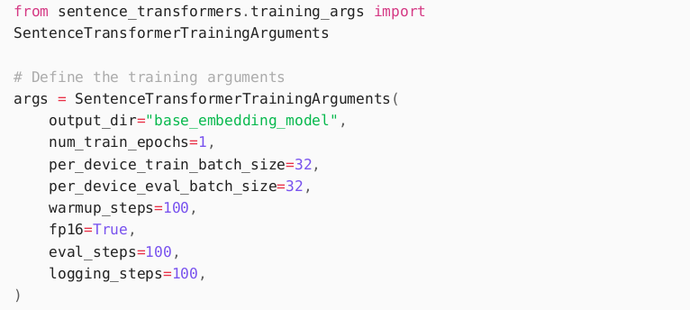
Train Model
Then we create, SentenceTransformerTrainingArguments , similar to training with Hugging Face Transformers:

Slide 20
Train Model
See the following arguments:
num_train_epochs: the number of training rounds. Higher values mean better model performance.
per_device_train_batch_size: the number of samples to process simultaneously on each device (e.g., GPU or CPU) during evaluation. Higher values generally means faster training.
per_device_eval_batch_size: the number of samples to process simultaneously on each device (e.g., GPU or CPU) during evaluation. Higher values generally mean faster evaluation.
warmup_steps: the number of steps during which the learning rate will be linearly increased from zero to the initial learning rate defined for the training process.
fp16: by enabling this, we allow for mixed precision training, where computations are performed using 16-bit floating-point numbers (fp16) instead of the default 32-bit (fp32), reducing memory usage and potentially increases the training speed

Slide 21
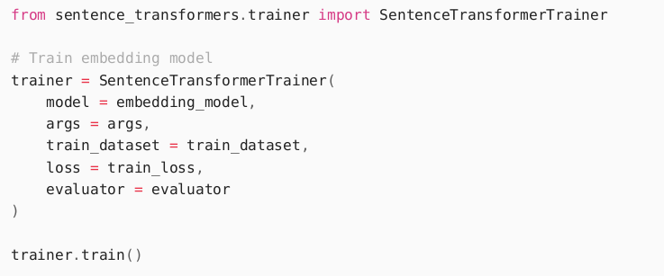
Train Model
Now that we have the model (BERT base model (uncased)), loss (softmax), and evaluator (SBST), we can start with the training:

Slide 22
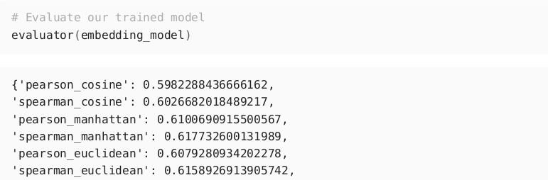
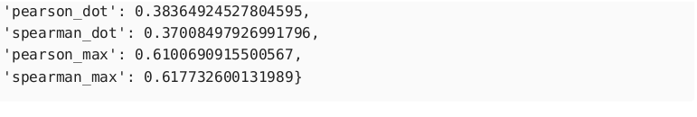
Train Model
After training the model, we can use the evaluator to get the performance on this single task:

Slide 23
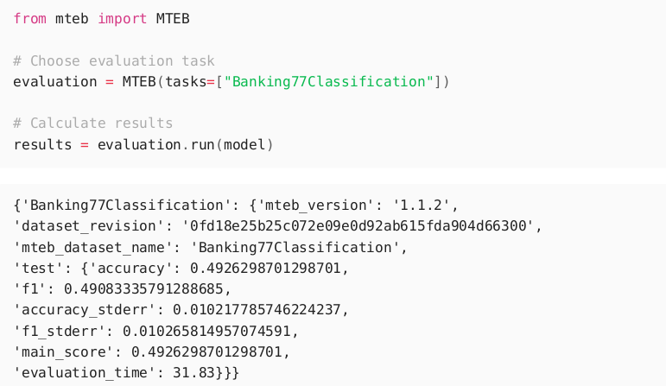
Train Model
In-Depth Evaluation
Massive Text Embedding Benchmark (MTEB) unifies the many benchmarks including GLUE. It covers 8 embedding tasks, 58 datasets, and 112 evaluations.

Slide 24
Loss Functions
We trained our model using softmax loss to illustrate how one of the first sentence-transformers models was trained. But softmax is generally not advised, as there are better loss functions.
Two loss functions perform well generally:
Cosine Similarity
Multiple Negatives Ranking (MNR) Loss

Slide 25
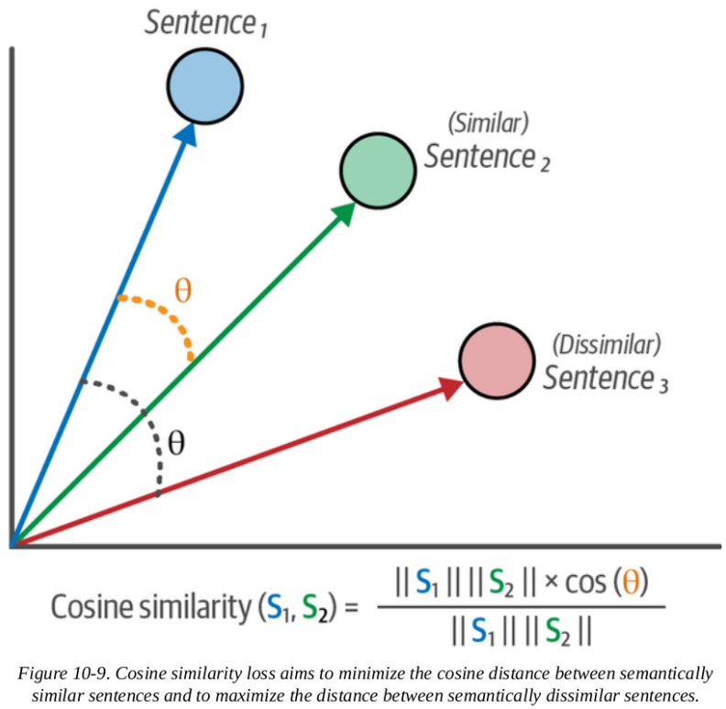
Loss Functions
Cosine Similarity
Typically used in semantic textual similarity tasks, where a similarity score is assigned for a pair of texts to optimize the model.
Quantifies the degree to which 2 texts are similar or not (not classification)

Slide 26
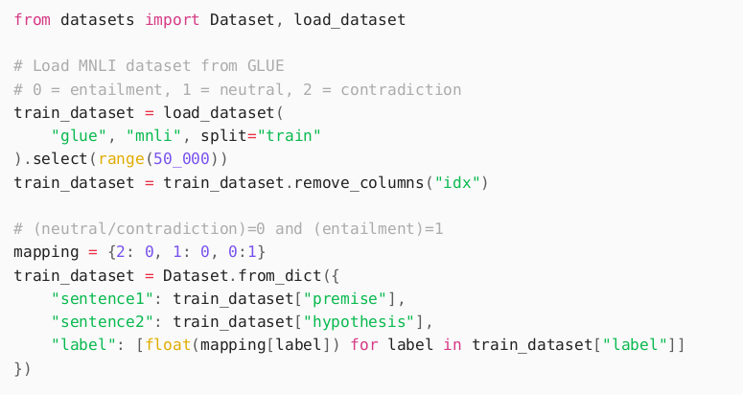
Loss Functions
Cosine similarity is usually a value between 0 and 1. To use the loss with the NLI, we need to convert the values entailment (0),neutral (1), and contradiction (2) to values between 0 and 1.

Slide 27
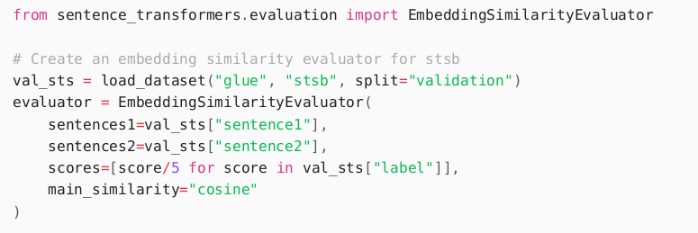
Creating an Embedding Model
Let's create our evaluator:

Slide 28
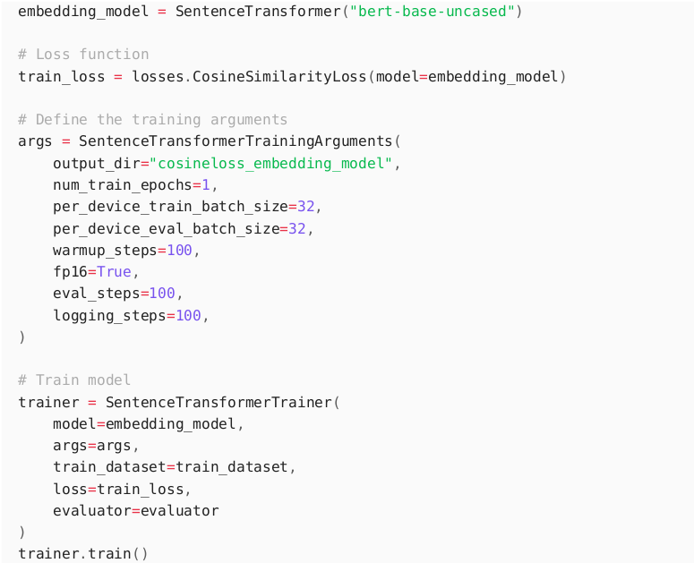
Creating an Embedding Model
Then, we follow the same steps as before to train the model but select a different loss (cosine similarity loss) instead:

Slide 29
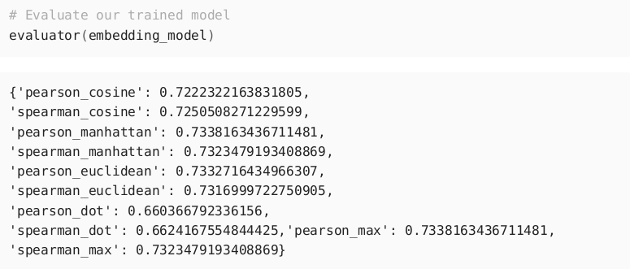
Creating an Embedding Model
After the training, we can evaluate the performance of the model:
Remember that the pearson cosine was 0.59. This increase to 0.72 shows the importance and impact of loss function on performance.

Slide 30
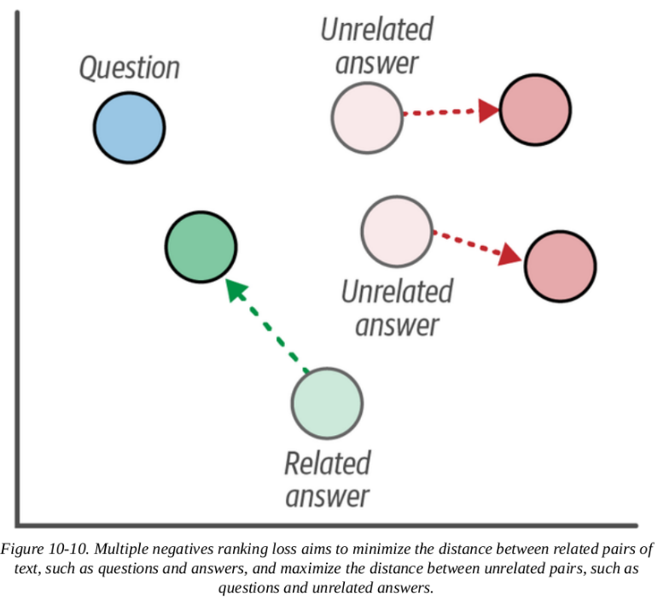
Creating an Embedding Model
Multiple Negatives Ranking (MNR) Loss
also referred to as InfoNCE or NTXentLoss, uses either positive pairs of sentences or triplets that contain a pair of positive sentences and an additional unrelated sentence (called a negative).
This negative sentence represents the dissimilarity between the positive sentences.

Slide 31
Creating an Embedding Model
Multiple Negatives Ranking (MNR) Loss Examples:
Pairs: Apple - Banana (fruit - fruit)
Tiger - Cat (animal - animal)
Chopper - Airplane (Flying vehicles)
Positive pair:
Apple (anchor sentence) - Banana (positive)
Negative pair:
Apple - Airplane (negative)
Apple - Cat (negative)

Slide 32
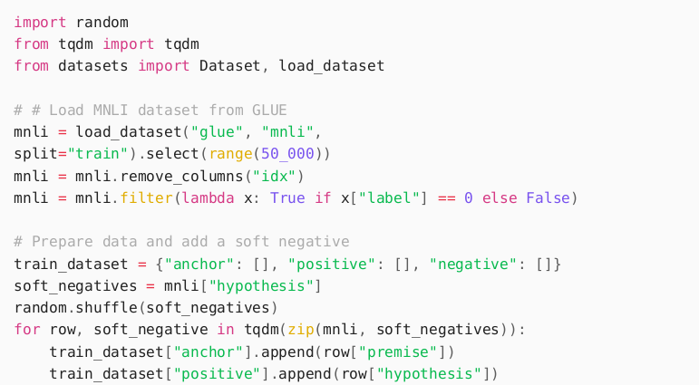
Creating an Embedding Model
Multiple Negatives Ranking (MNR) Loss
To make these pairs from the MNLI dataset that we have, we start with anchor sentence (i.e., labeled as 'premise'). To add negative sentences, we randomly sample sentences as the 'hypothesis.'

Slide 33
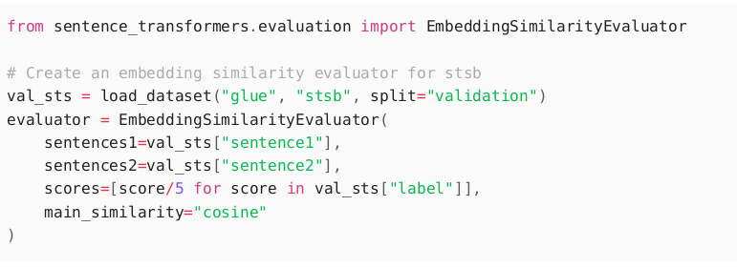
Creating an Embedding Model
Multiple Negatives Ranking (MNR) Loss
Let's define the evaluator:

Slide 34
Creating an Embedding Model
Multiple Negatives Ranking (MNR) Loss
We use the same code as before but we use MNR loss instead of cosine similarity loss:

Slide 35
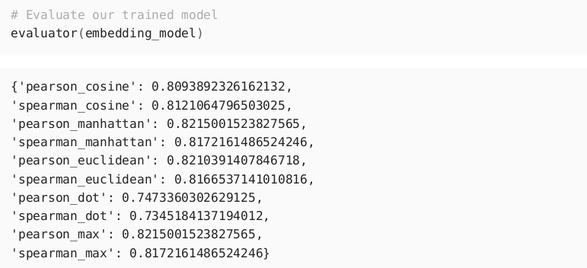
Creating an Embedding Model
Let's see how MNR loss compares to previous loss functions:
Recall that the pearson cosine from when we used softmax was 0.59, with cosine 0.72, and now we have 0.80.

Slide 36
Creating an Embedding Model
Because we randomly sampled our negatives, the negatives that we used are potentially completely different and unrelated to the question (anchor).
This makes it really easy for the model to differentiate them
In real life, this would mean that the model would struggle to differentiate between sentences like:
'How many people live in Amsterdam?'
‘More than a million people live in Utrecht, which is more than Amsterdam'

Slide 37
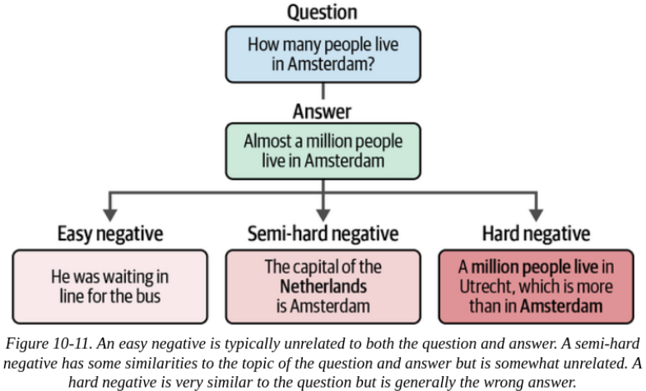
Creating an Embedding Model
To address this, we would need to have negatives that are very related to the answer but is not the right answer
These negatives are called hard negatives

Slide 38
Creating an Embedding Model
Gathering negatives can be divided into three processes:
Easy Negatives
Through random sampling documents (what was done in the example).
Semi-hard Negatives
Using an embedding model to generate embeddings for sentences and using cosine similarity to find those that are highly related.
Hard Negatives
These are manually labeled or a generative model is used to either label or generate sentence pairs.

Slide 39
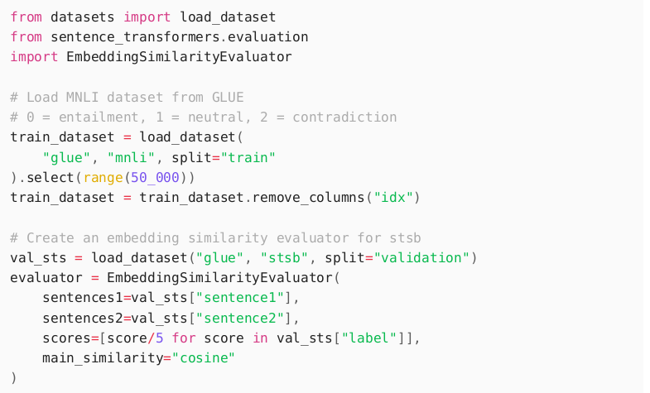
Fine-Tuning an Embedding Model
Supervised
Recall that supervised just means we show the model labels to data points.
We use all-MiniLM-L6-v2 from sentence-transformers

Slide 40
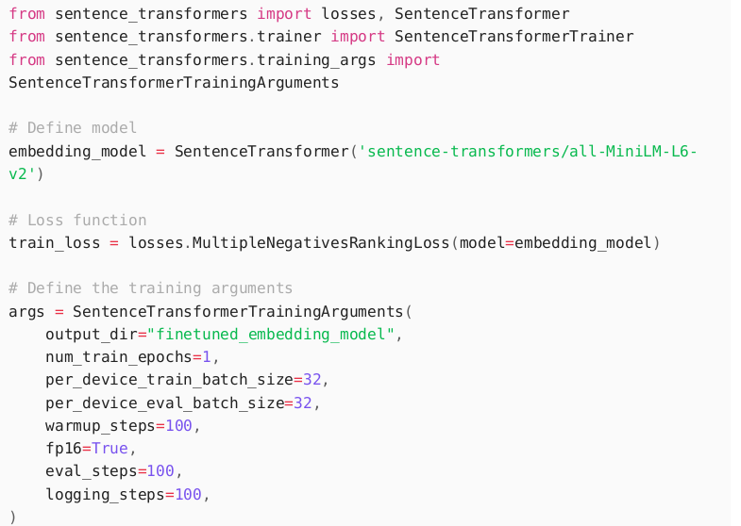
Fine-Tuning an Embedding Model
Supervised
Then we replace bert-base-uncased with the pretrained model:

Slide 41
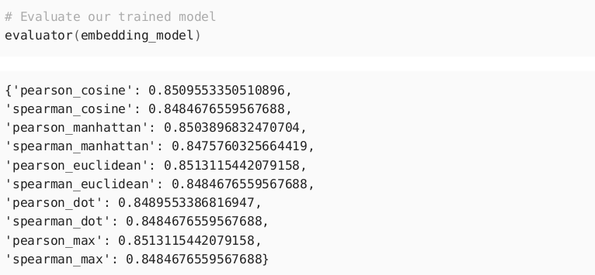
Fine-Tuning an Embedding Model
We follow the same steps as before (trainer function, not shown for brevity):
Score of 0.85 is the highest we have seen thus far. the pretrained model that we used for fine-tuning was already trained on the full MNLI dataset, whereas we only used 50,000 examples.

Slide 42
Augmented SBERT
Large amounts of labeled data is not always available. One way to augment data such that an embedding model can be fine-tuned is called Augmented SBERT.
Augmented SBERT involves the following steps:
Fine-tune a cross-encoder (BERT) using a small, annotated dataset (gold dataset)
Create new sentence pairs (or collect, unlabeled)
Use the fine-tuned cross encoder to label the unlabeled sentence pairs (results to silver dataset)
Train a bi-encoder (SBERT) on the extended dataset (gold + silver)

Slide 43
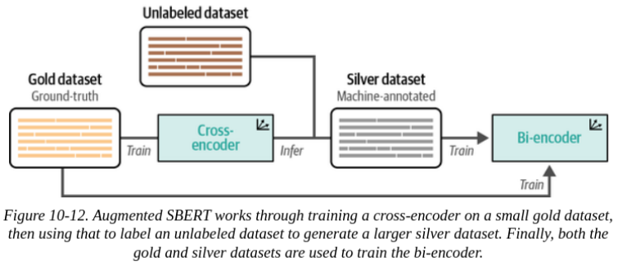
Augmented SBERT
Large amounts of labeled data is not always available. One way to augment data such that an embedding model can be fine-tuned is called Augmented SBERT.

Slide 44
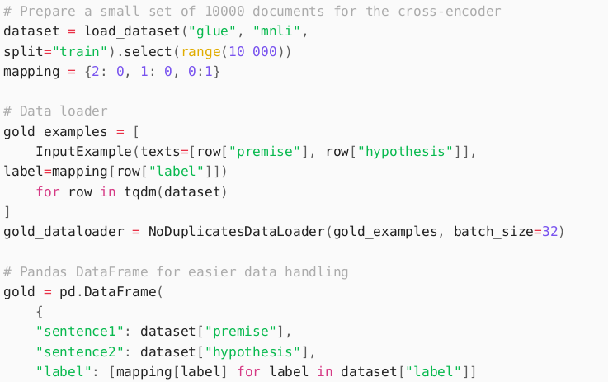

Augmented SBERT
To simulate a situation where there is little labeled data available, let's use 10,000 instead of 50,000.
The result is the gold dataset and it represents our ground truth.

Slide 45
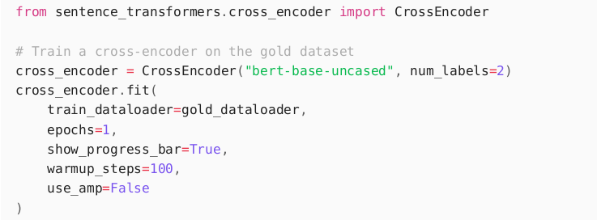
Augmented SBERT
We train the cross-encoder with this gold dataset (Step 1):

Slide 46
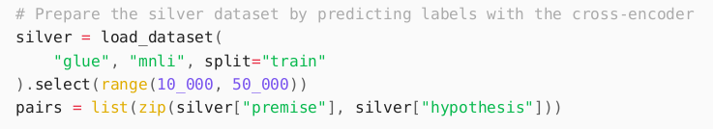
Augmented SBERT
Then we use the remaining 40,000 (from the 50,000) sentence pairs (silver dataset) as our silver dataset (Step 2):

Slide 47
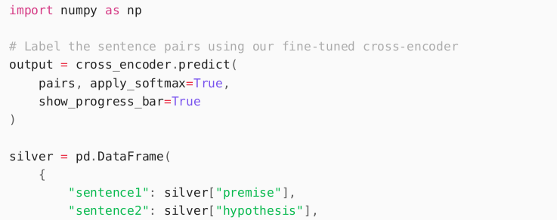

Augmented SBERT
Then, we label these 40,000 unlabeled sentence pairs using the fine-tuned cross-encoder (Step 3):
This output of this is the silver dataset which we combine with the gold dataset.

Slide 48
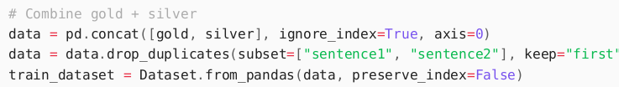
Augmented SBERT
We then use this extended dataset (gold + silver) to train bert-base-uncased as bi-encoder (Step 4):
Following the same steps as before (all in the book), we evaluate the model.
The original cosine similarity loss example had a score of 0.72 with the full dataset. Using only 20% of that data, we managed to get a score of 0.71. This shows the importance of Augmented SBERT when limited labeled data.

Slide 49
Unsupervised Learning
Unsupervised learning is a technique to train models when predetermined labels are not available
The idea of TSDAE (Transformer-Based Sequential Denoising Auto-Encoder) is that we add noise to the input sentence by removing a certain percentage of words from it.
A sentence embedding is then generated from this 'damaged' sentence.
A decoder then tries to reconstruct this sentence but without the artificial noise. The performance of the embedding model (encoder) is calculated based on how well the decoder reconstructed the sentence.

Slide 50
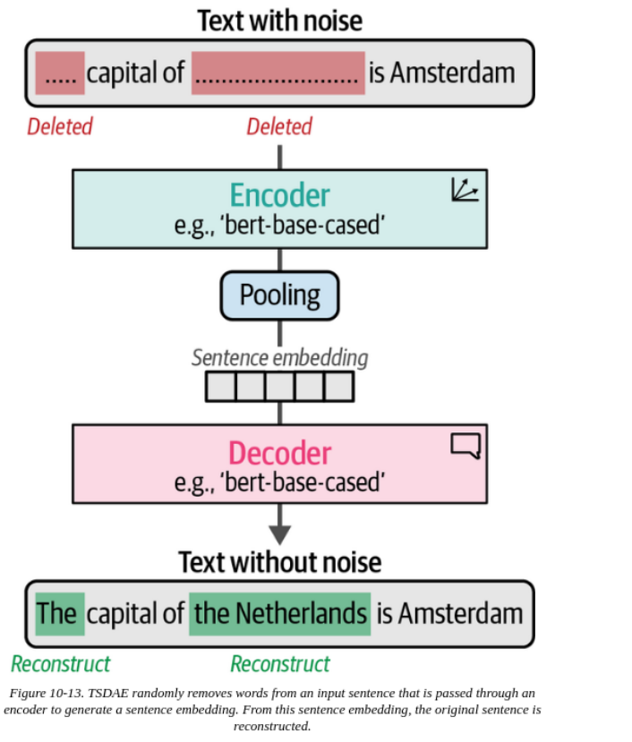
TSDAE

Slide 51

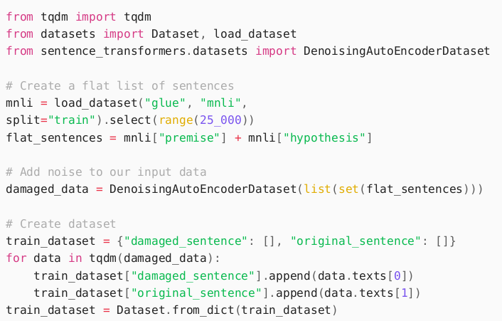
TSDAE
We start by downloading an external tokenizer, which is used for the denoising procedure:
This creates a dataset of 50,000 sentences.

Slide 52
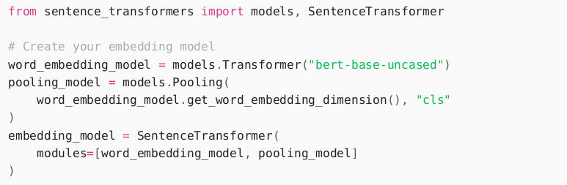
TSDAE
We run the training as before but with the [CLS] token as the pooling strategy

Slide 53
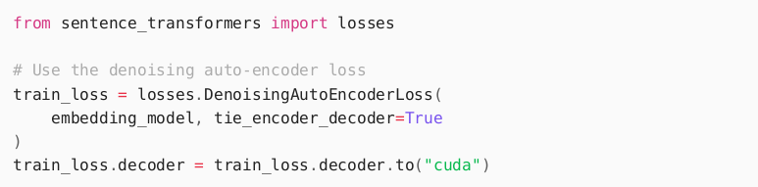
TSDAE
We use the DenoisingAutoEncoderLoss loss function that attempts to reconstruct the original sentence using the noisy sentence.

Slide 54
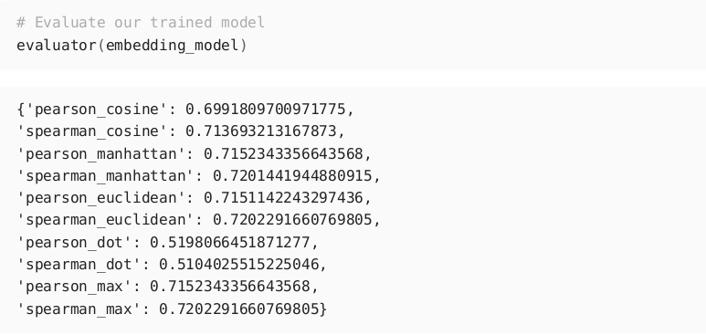
TSDAE
After training the model (same as previous times), we evaluate the model:
We get a score of 0.70 using unlabeled data.

Slide 55
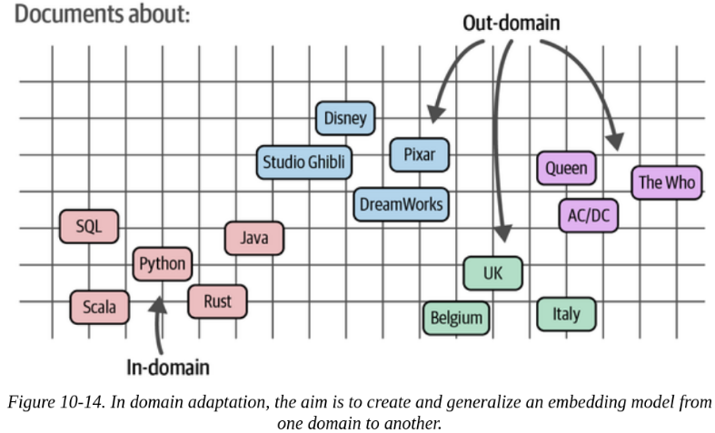
TSDAE
Using TSDAE for Domain Adaptation
Domain Adaptation’s goal is to update existing embedding models to a specific textual domain that contains different subjects from the source domain.

Slide 56
END

